Slide 1
DeepSeek-R1: Incentivizing Reasoning Capability in LLMs via Reinforcement Learning
Paper Explained By Ali Reza Torabi,
Amir Hossein Aghazadeh , Alireza Nosrati

Slide 2
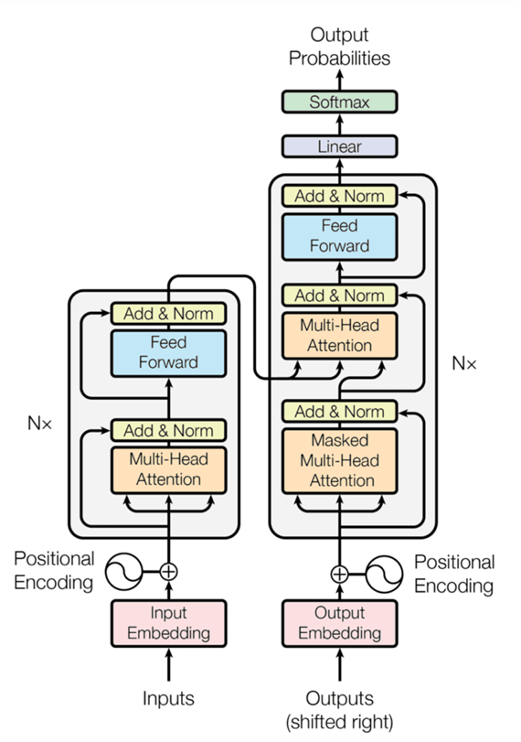
Understanding The Transformer Architecture :
Input Embeddings and Tokens and Positional Encoding
Attention Mechanism
Feed Forward Neural Network
Output Probabilities

Slide 3
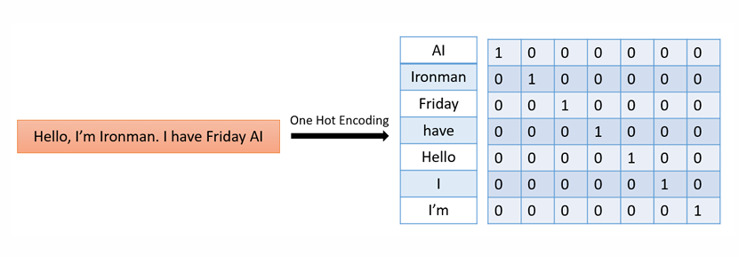
To process text effectively, the first step is to represent words in a way that models can understand.
1.1 One Hot Encoding:
The length of the one-hot vector depends on the number of unique words in the vocabulary

Slide 4
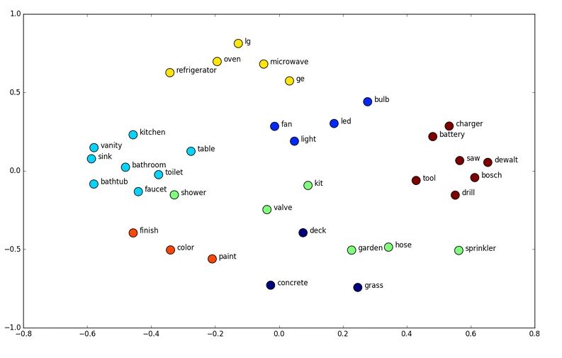
1.2- Input Embedding

Slide 5
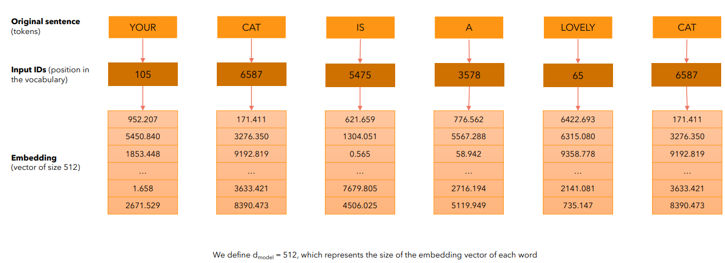
What is an Input Embedding ?

Slide 6
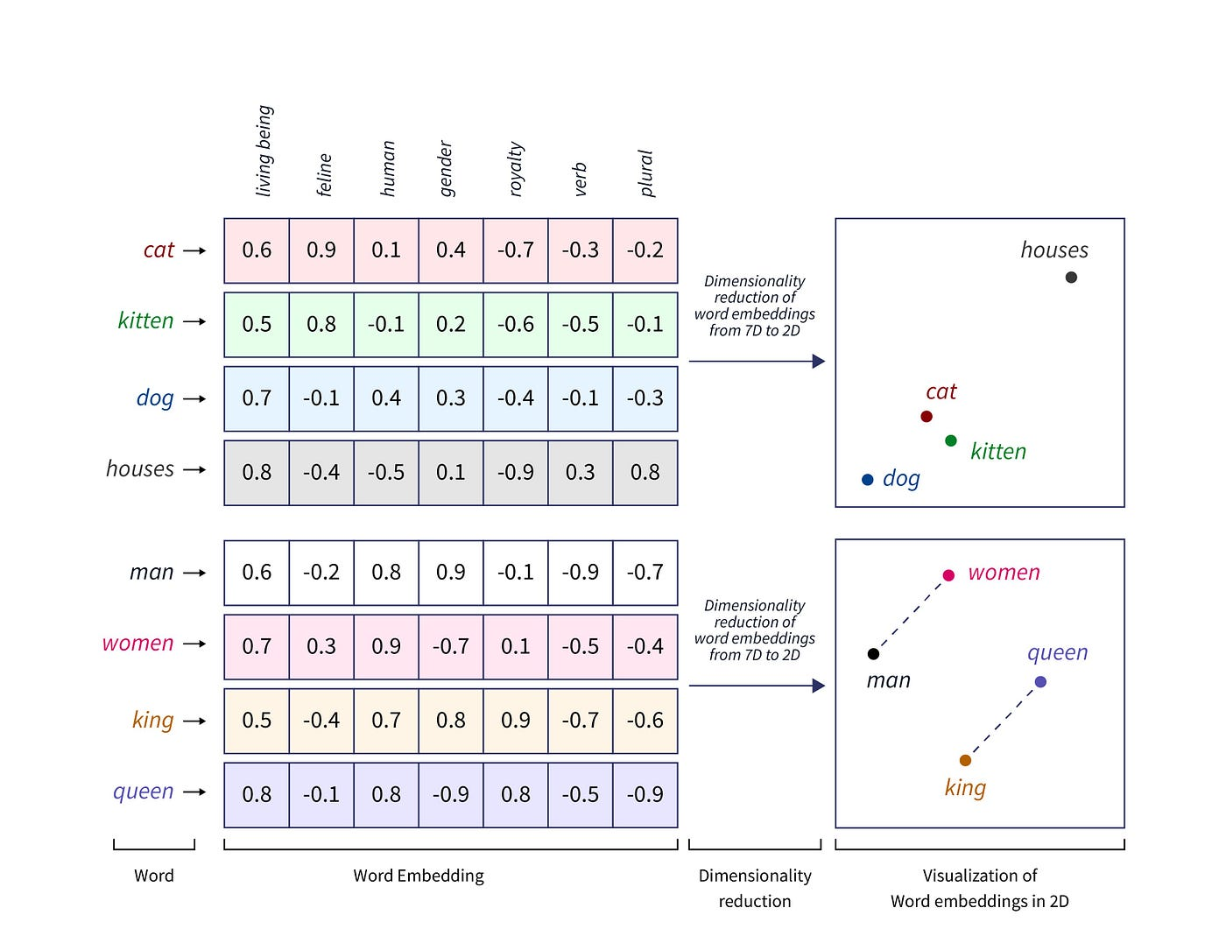

Slide 7
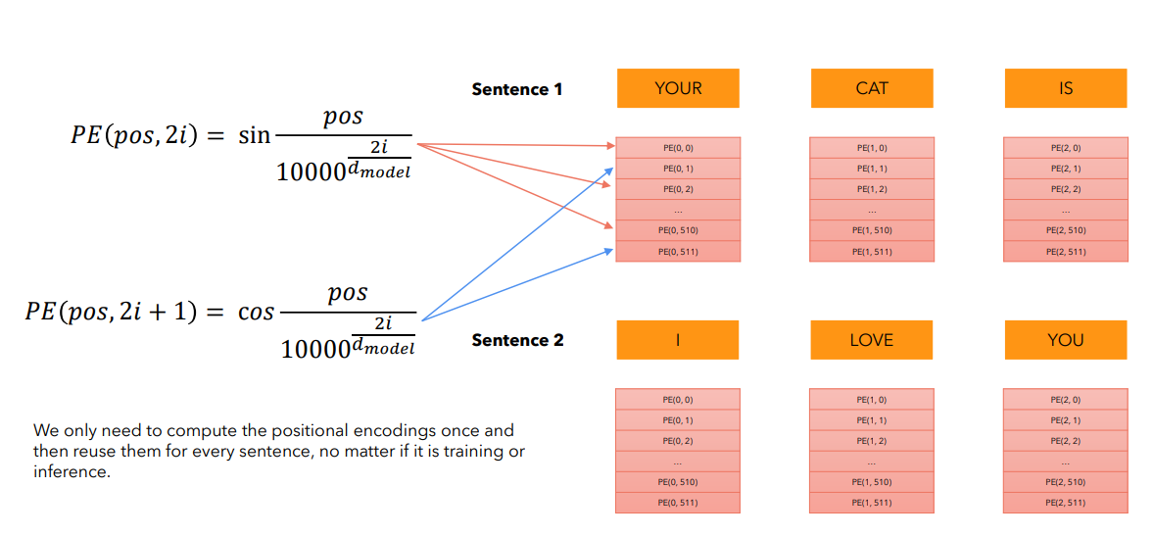
Input Embedding + Positional Encoding = Attention Input

Slide 8
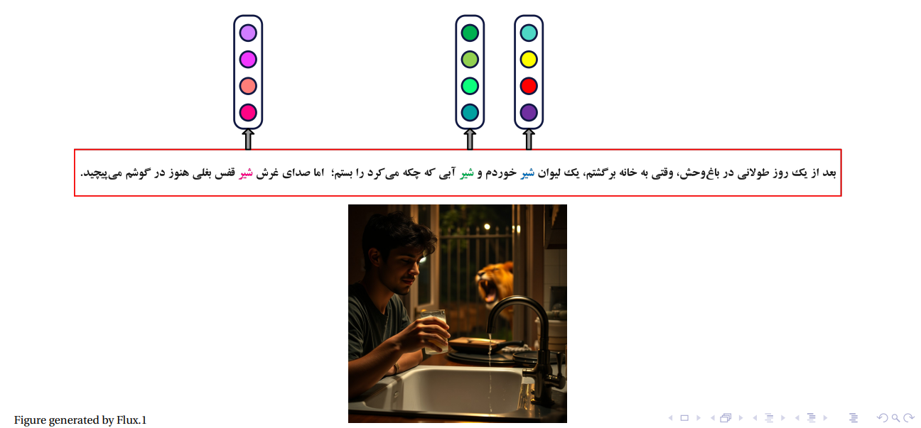
Why We Need Attention ?

Slide 9
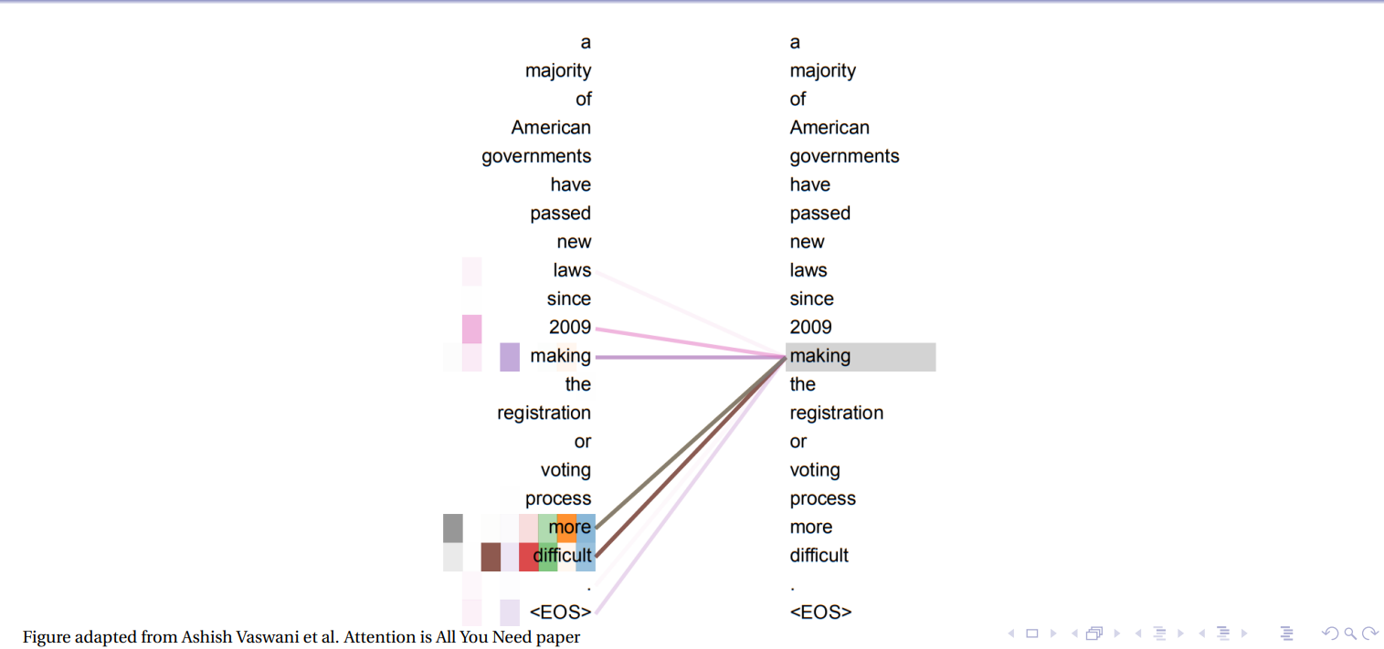

Slide 10
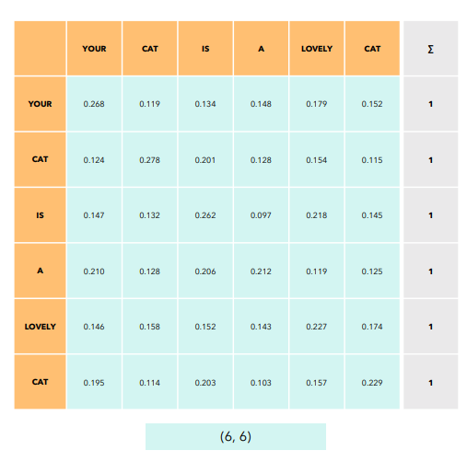
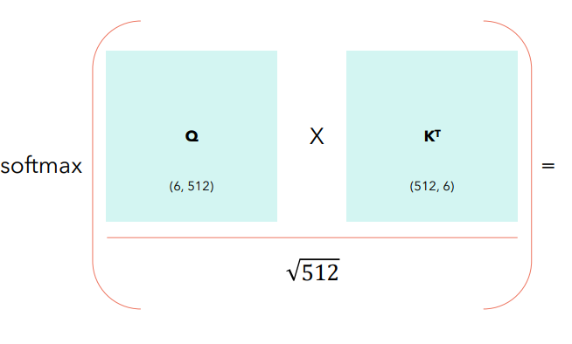
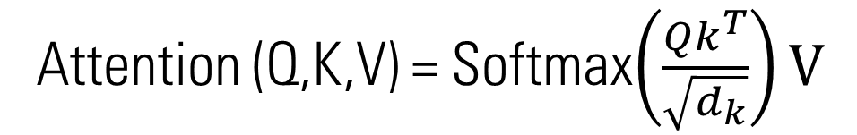
Attention Is All You Need
Attention (Q,K,V) = Softmax$\left(\frac{Qk^{T}}{\sqrt{d_{k}}}\right)V$
What Is Self Attention ?
Self attention allows the model to relate words to each other.

Slide 11
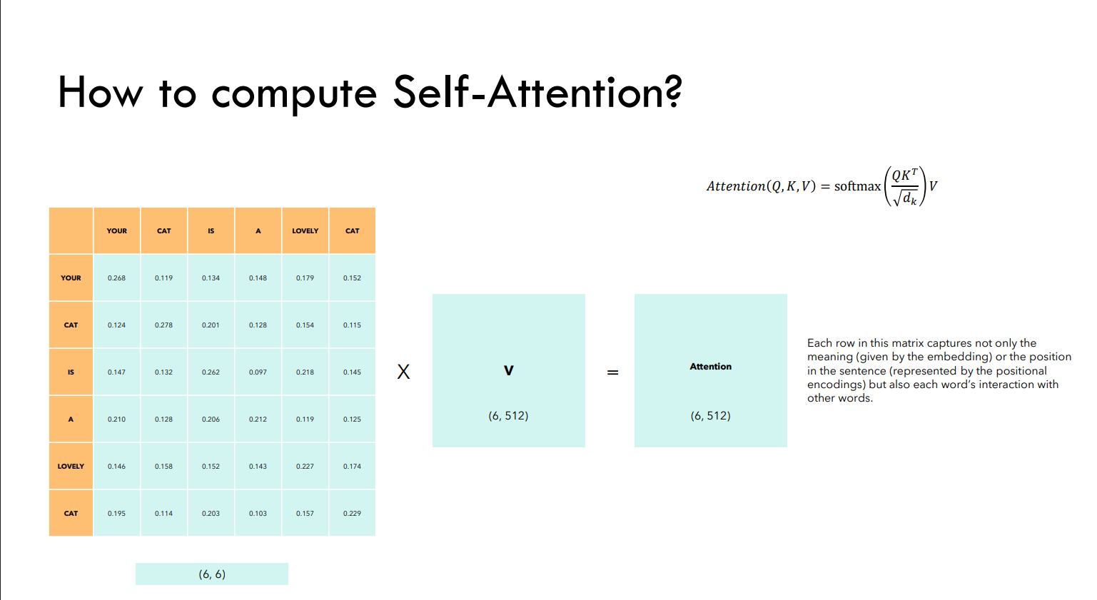
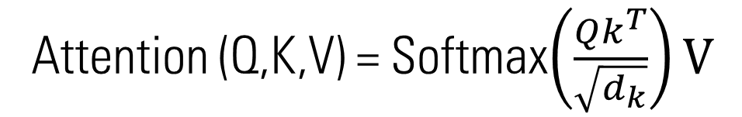
Attention (Q,K,V) = Softmax$\left(\frac{Qk^{T}}{\sqrt{d_{k}}}\right)V$

Slide 13
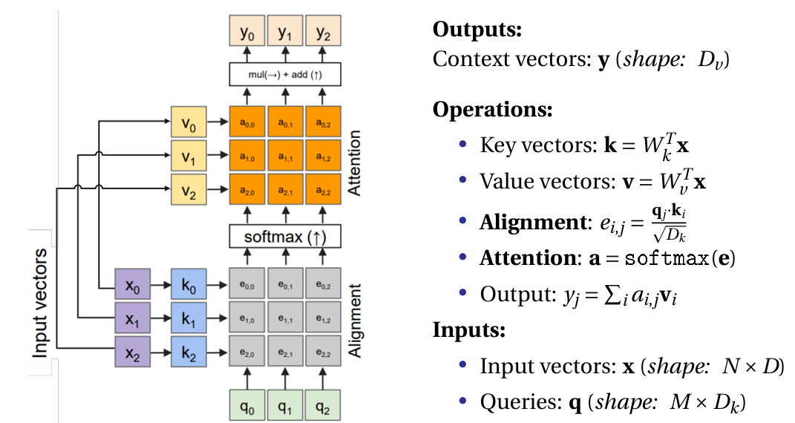

Slide 14
Deepseek R1, Why Does it Matter ?

Slide 15
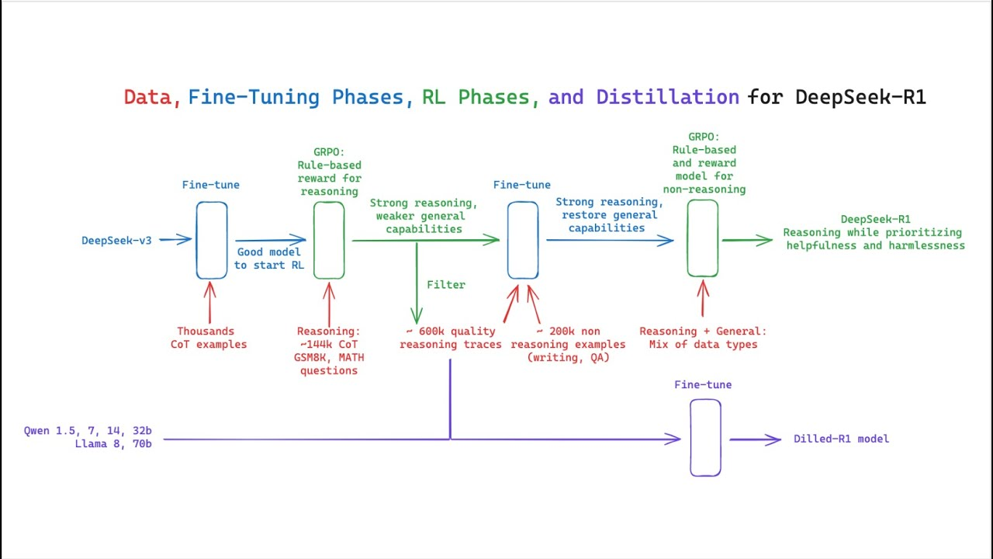

Slide 16
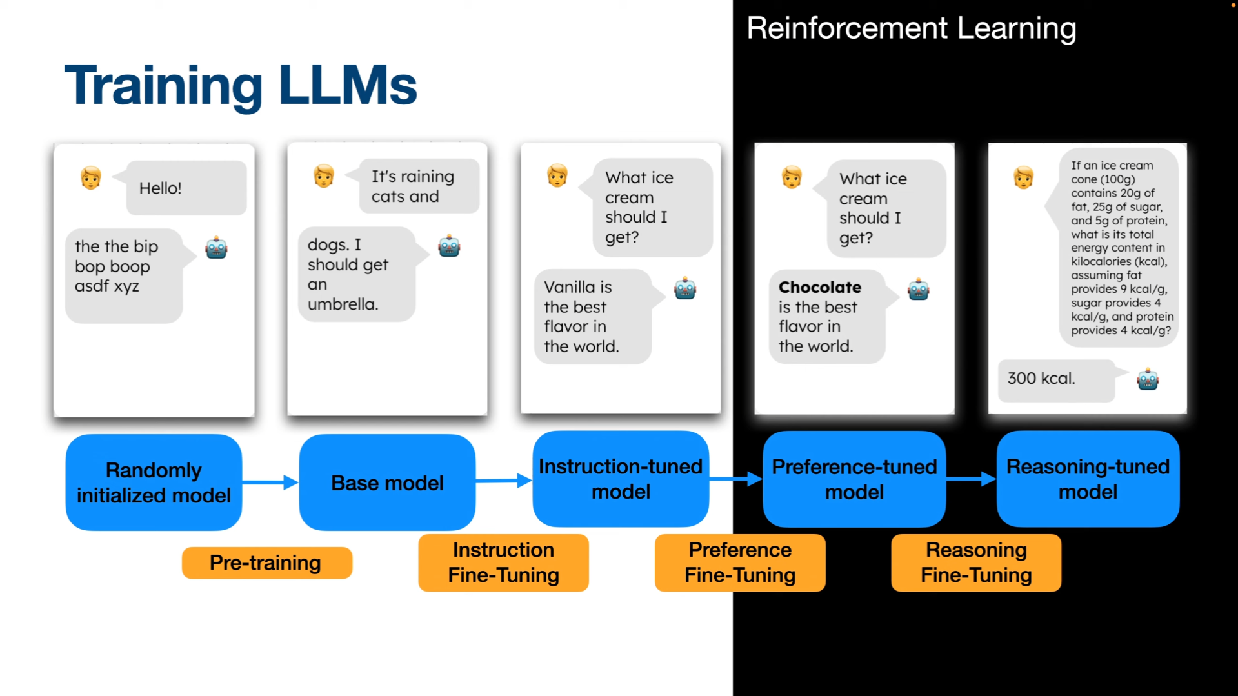

Slide 17
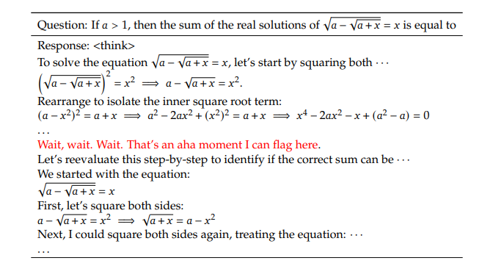

Slide 18
An interesting “aha moment” of an intermediate version of DeepSeek-R1-Zero. The model learns to rethink using an anthropomorphic tone. This is also an aha moment for us, allowing us to witness the power and beauty of reinforcement learning.

Slide 19
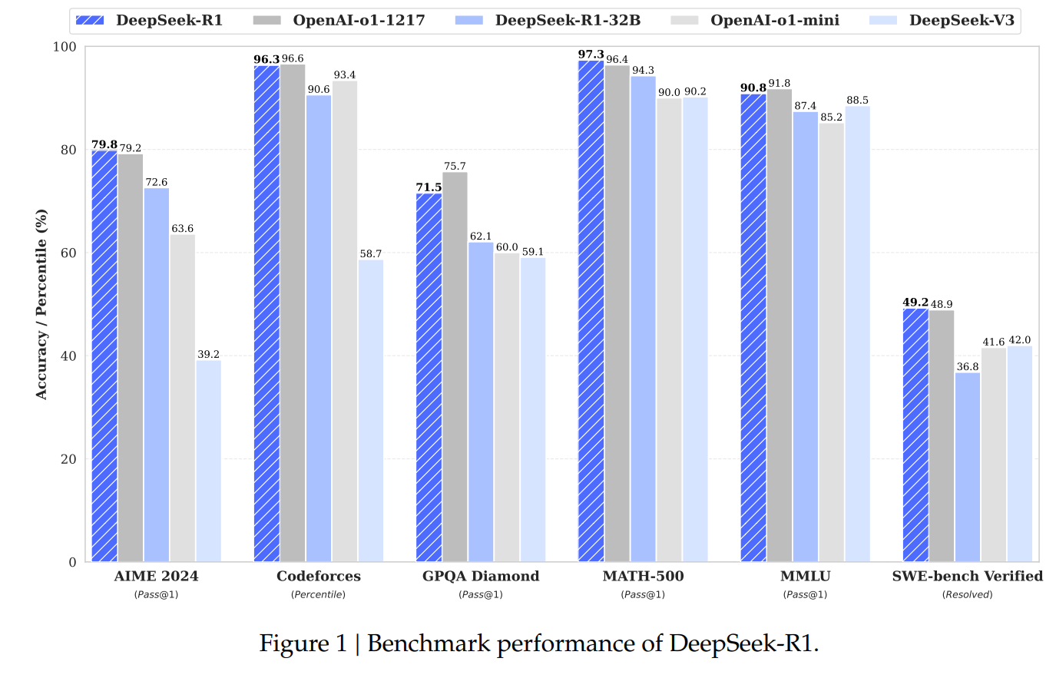

Slide 20
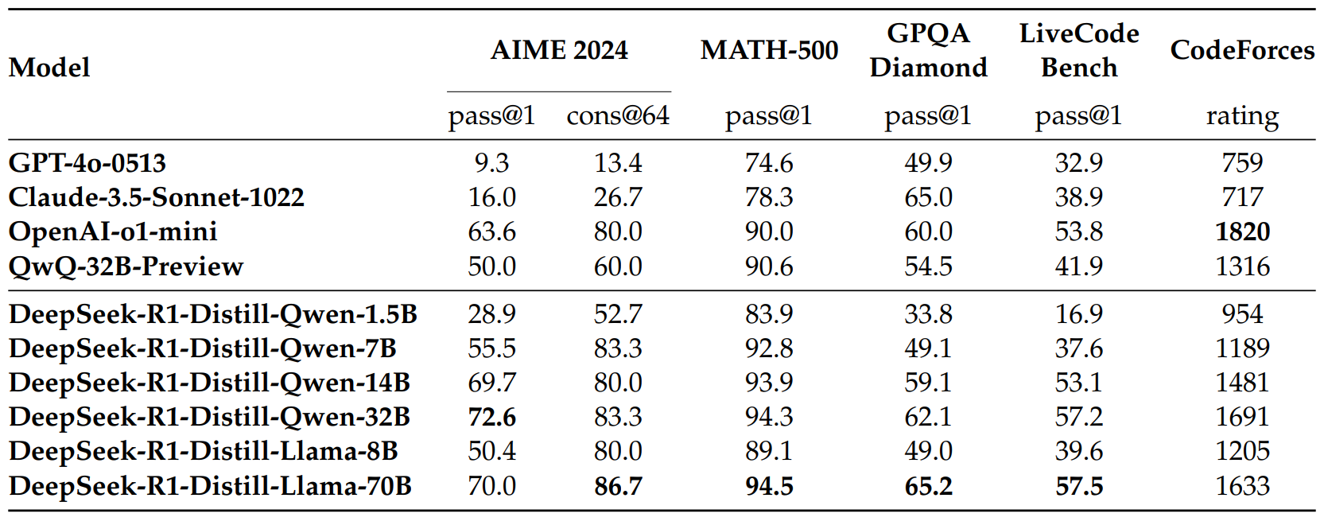

Slide 21
My Portfolio Website:
alirezatorabidev.vercel.app
Files Available at :
github.com/nullxxnerd/deepseekR1-presentation
References: Sharif Machine Learning Course
https://github.com/hkproj
https://github.com/deepseek-ai/DeepSeek-R1/blob/main/DeepSeek_R1.pdf

